Slide 1
DELHI COURTS MOBILE
APP
Presentation By : Talwant Singh
District & Sessions Judge : East Distt. (Delhi)

Slide 2
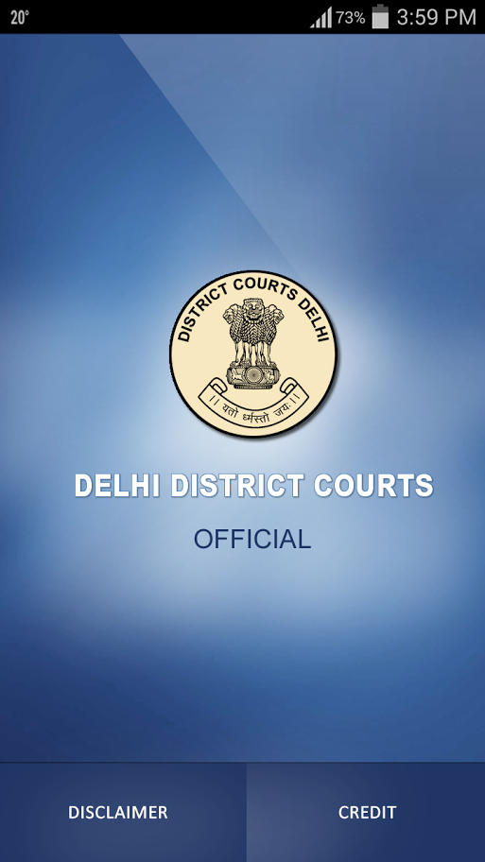
HOME SPLASH SCREEN
Contains Logo and check internet connection in the Backgroud.
Redirects to main screen in 2-3 seconds.

Slide 3
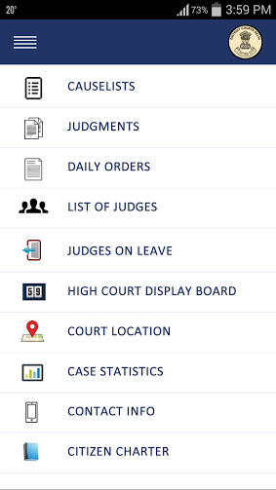
MAIN MENU SCREEN
Contains several menu items and utilities available in the app.

Slide 4
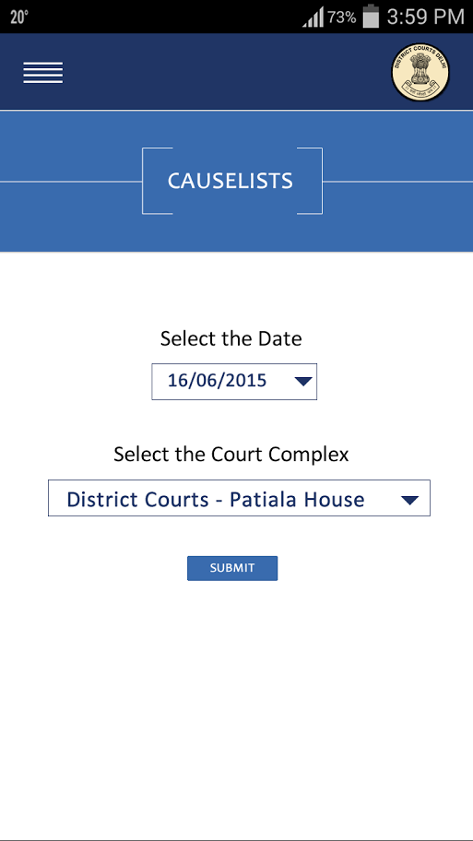
CAUSELIST SCREEN
First screen asks for date and court complex for which Causelist is required.

Slide 5
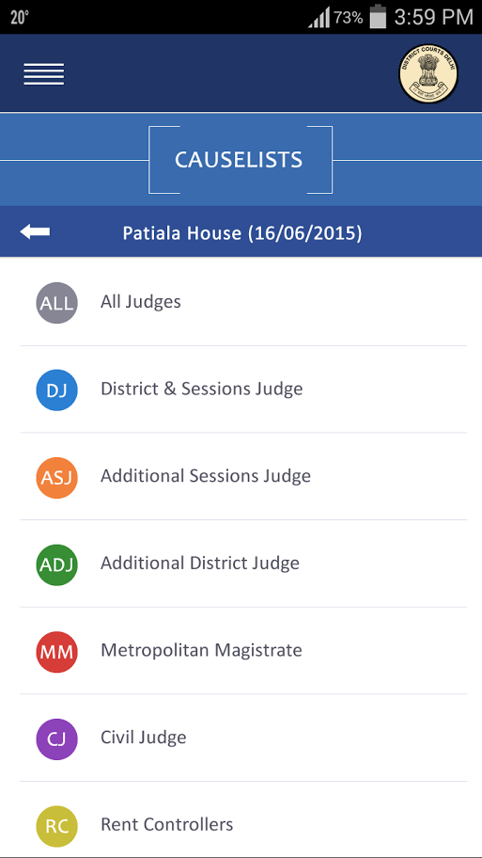
CAUSELIST SCREEN
Second screen asks the designation of judges for which the order is required.

Slide 6
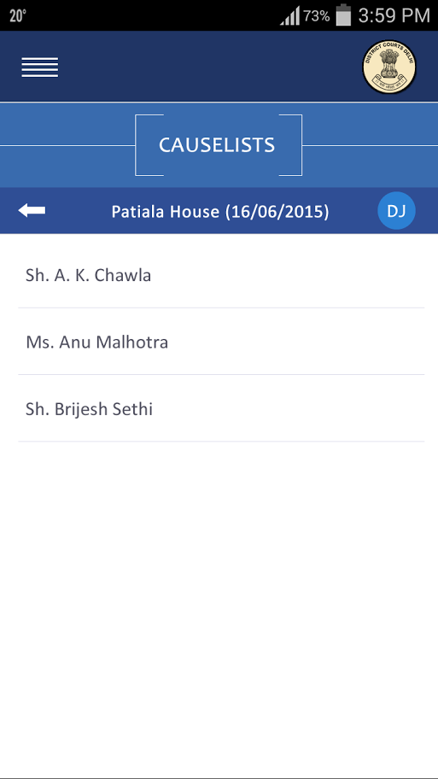
CAUSELIST SCREEN
Third screen prompts name of Judges whose causelist is available in the system and displays upon touch on the name of the judges.

Slide 7
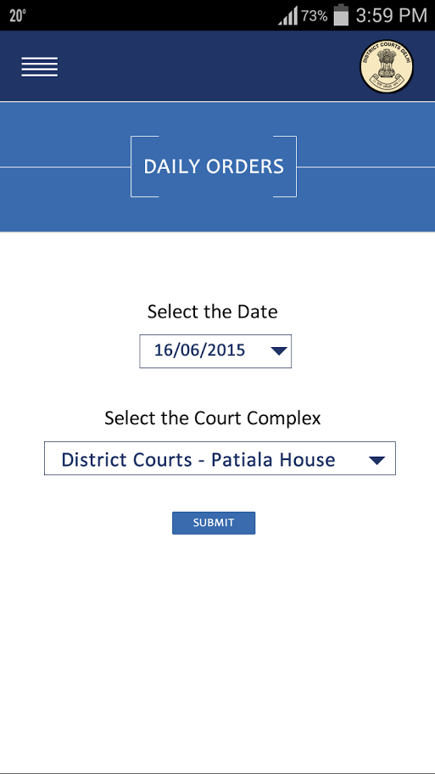
DAILY ORDER SCREEN
Daily orders section works similarly on the pattern of Causelist and displays the Daily Order and so the Judgement section works.

Slide 8
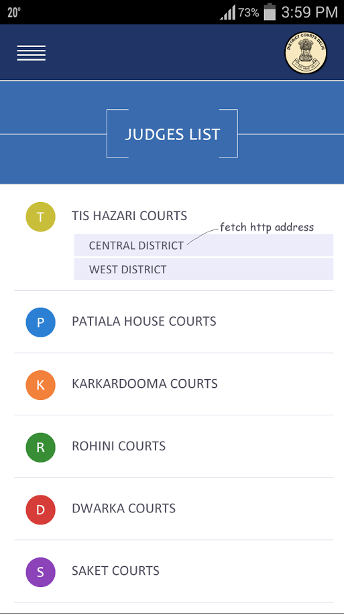
JUDGES LIST SCREEN
Judges List screen displays the list of Judges District wise and Complex wise with their name, Designation and Room No. in which they hold the court.

Slide 9
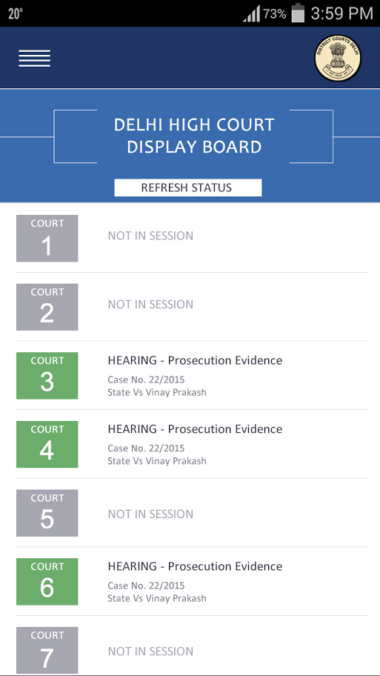
HIGH COURT CASE DISPLAY SCREEN
This screen displays live case listing of the Delhi High Court court number wise and refreshes automatically if another matter is hearing by Hon’ble Judge.

Slide 10
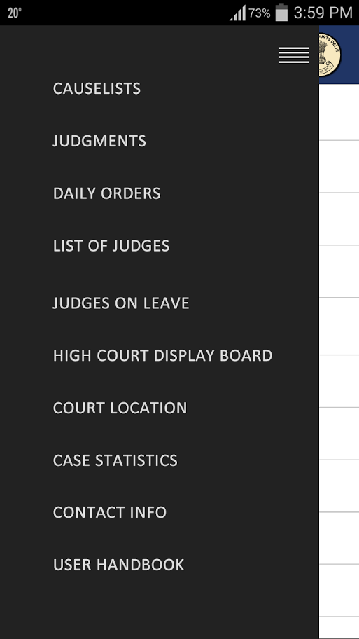
SLIDER MENU
Slider menu is available on touch of the left top Hamburger icon which displays all the available menu in the map if you are anywhere in the app.

Slide 11
THANK YOU
Talwant Singh
District & Sessions Judge :
East DistRICt. (Delhi)

